Slide 1
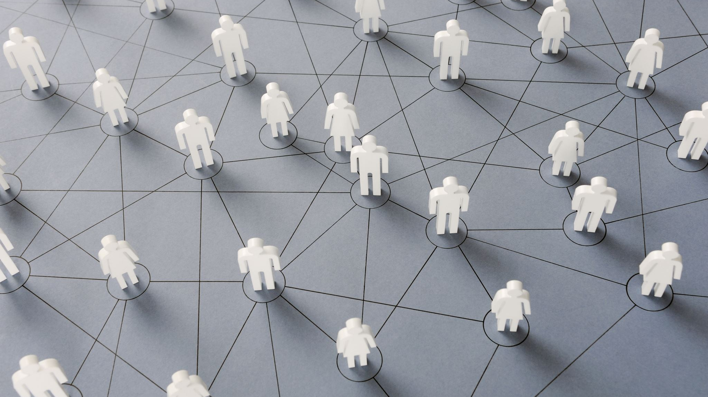
Technological Influence on Society
Angela Alves

Slide 2
3 Major Elements Influenced
Communication
Information Access & Consumption
The Workplace

Slide 3
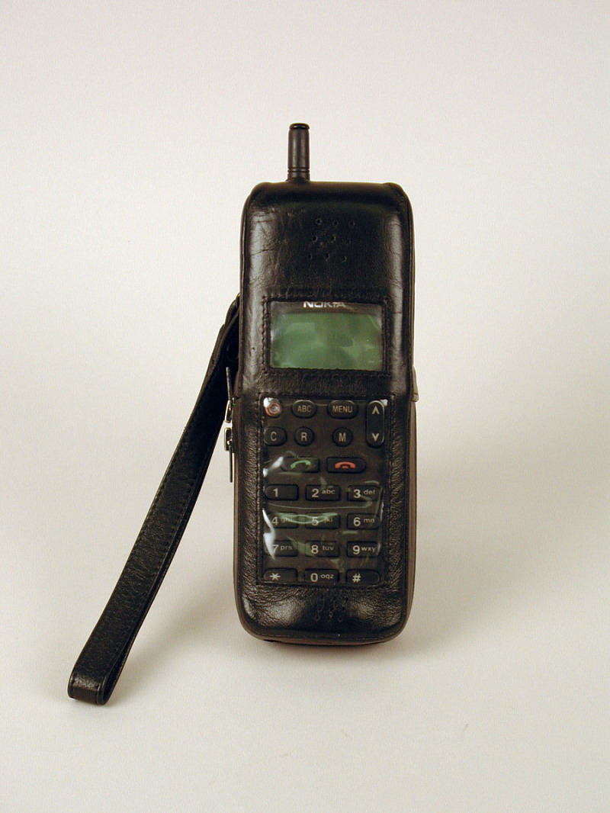
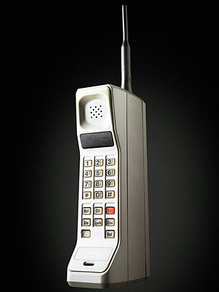
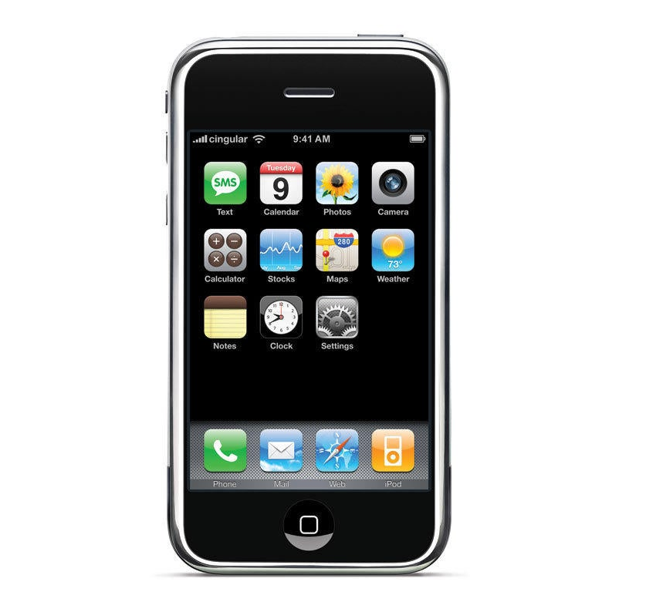
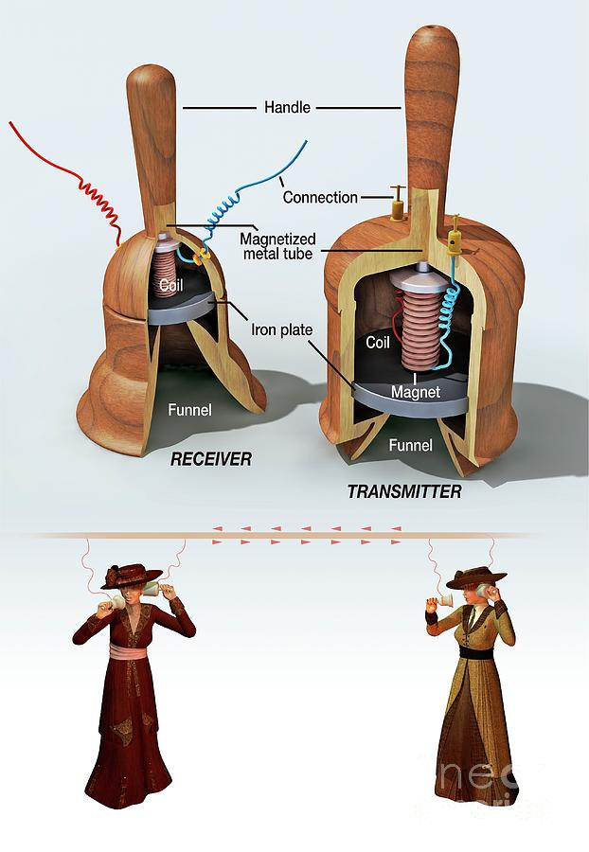
Evolution of Technology Reshaping Communication
1st Primary Phone - (1849)
Was invented by Italian innovator Antonio Meucci
Invented by Motorola
1st mobile phone w/ QWERTY keyboard - (1996)
Invented by Nokia
1st mobile phone – (1973)
1st iPhone - (2007)
Invented by Apple CEO Steve Jobs
The evolution of the telephone paved the way for multiple new adaptations and inventions that kicked off transformation in communication forever. It brought us to our current models of Android touch-screen phones.They became an essential item in society due to their flexibility, privacy, portability, accessibility, and enhanced efficiency in staying connected.

Slide 4

New Tools of Communication
Internet: It allowed people to stay in touch faster and easier with others from any location by enabling instant messaging, video chats, forums, social media platforms, simplified document creation and sharing.
Email: It made relaying messages faster than traditional handwritten letters that are now used in business, personal,& educational institutions interactions
Social Networking: Platforms like Facebook, Instagram, Messenger and X allowed and aided people to stay connected with all people no matter where they are, breaking geographical barriers without needing postage or office visits.
Wearable Technology: Since the creation of bluetooth in 1999, wearable tech like smartwatches and earbuds evolved and enabled hands-free communication that has become fundementally used items in daily life.
Virtual Reality (VR): It is a powerful communication tool that has allowed people and especially businesses to flourish by enabling immersive, distraction-free interactions that helps faciliate greater communication by capturing non-verbal cues, improved focus, and aids in overcoming language barriers.
All factors transformed the way we look at communication today – by enhancing speed, quality & accessiblity

Slide 5
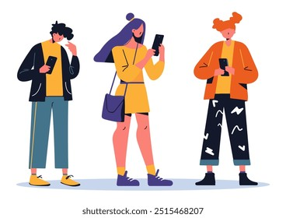
Effects on Comunication
Society has negatively shown a...
Dependency on technology
Decline in face-to-face interactions
Decrease in the quality of social interactions
Weakened social skills
Reduction of empathy & emotional depth

Slide 6

Resolutions
Actively prioritizing quality in-person conversations
Planning regular meetups with friends and family
Prioritizing other activities
Limit technological usages & unplugging when it's necessary
Being mindful and paying attention in digital communication non-verbal cues (emojis & punctuation), tone, plus written language to avoid miscommunication
Practicing active listening

Slide 7
Effects on Information Access & Consumption
Americans access their news from a division of different pathways:
(52%) prefer a digital platform
(26%) go to a news website
(12%) go to social media
(3%) go to podcasts
(35%) prefer television
(7% to 5%) prefer the radio or via print
Digital technology has played a significant role in how society accesses information. The digital world has transformed how people produce, deliver, consume, and process news received worldwide. With the advancement of mobile technologies and smartphones, social media platforms gradually dominated the local news channel and the average morning paper when it comes to keeping up with world news.

Slide 8
Issues & Resolution
However, with the Internet spreading news faster, the ability to access information in a matter of seconds, given by multiple different avenues simultaneously, has resulted in a new phenomenon that occurs when users consume too much information. Information overload - causes confusion, impaired focus, and increased anxiety, with 20% of people reporting mental fog due to too much information
Social media and apps can personalize your news feed by using algorithms – that use previous searches and track your behavior as information to tailor to you, leaving a person stuck in an information filter bubble - limits exposure to diverse perspectives.
To escape filtered bubbles, you must actively manage digital media consumption and seek multiple viewpoints. To combat information overload, clear your mind by unplugging from digital technology for a couple of hours a day and be surrounded by the natural world.

Slide 9

Transformation of the Workplace
Not long ago, most businesses filed documents, stored them in folders, and kept them in cabinets; now, work environments have become paperless and entirely technologically run. The evolution of technology has completely transformed the way society operates.It began in the '60s and '70s when the workplace functioned solely with typewriters, rotary phones, and filing cabinets and was manual labor. By the ‘80s, the introduction of personal computers shifted workplaces to become digital, and by the '90s, the Internet, mobile phones, and email reformed communication.

Slide 10

The Evolution of the Workplace
In this new millennium, Cloud computing tools, VPNs, AI tools, and collaboration tools like Zoom, Google Workspace, and other project management platforms have enabled remote work, optimized workflows, and allowed flexible work arrangements to help employees work effectively and collaboratively from anywhere. Space management tools and apps are now crucial in businesses to help optimize office layouts, automate desk bookings, and track space utilization, allowing companies to make data-driven decisions, monitor occupancy levels, assist in contact tracing, and help reduce costs and create safer work environments to overall better employee experience

Slide 11
Effects on the Workplace Due to Technological Integration
Advantages
Enhanced productivity
Improved communication
Disadvantages
System distruptions
Overreliance on digital communication
Enables Remote work
Assistants of AI tools
Assistants of space management tools
Compliance & Consistency
Dependency risks
Security & Privacy risks

